Slide 1
Lesson 02 Trigonometry Interactive Seminar
E114 – Mathematics for Engineering

Slide 2
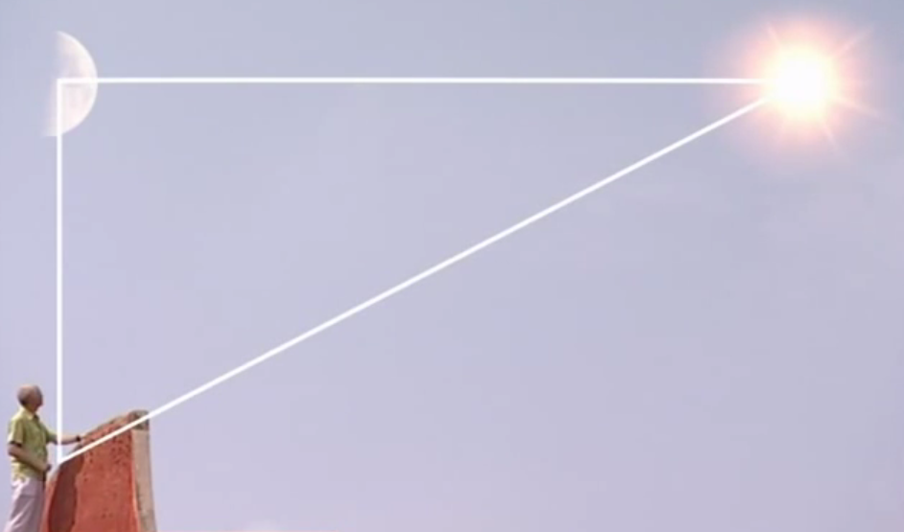
How Trigonometry came about?
https://youtu.be/1s7V7Ai3Eaw

Slide 3
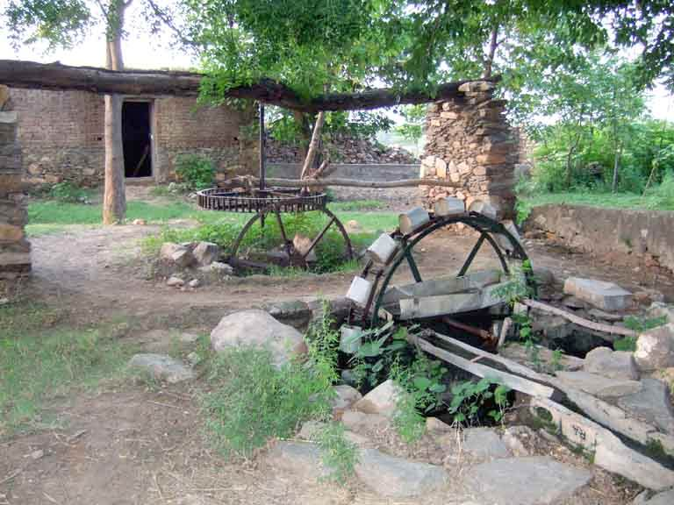
Scenario
One of the traditional functions of a water wheel is for irrigation purposes.
Usually, a water wheel is slung with many buckets so that it can carry water from a flowing river to an elevated and dry area where crops are grown and require irrigation.
You can view a water wheel in action here:
http://www.youtube.com/watch?v=z6JT1JJcSIw&feature=related

Slide 4
Scenario
The figure on the right shows a typical water wheel which has a radius r₁.
Taking the x-axis and y-axis as the reference levels, h₁ and w₁ refer to the vertical and horizontal displacements of a red dot (which represents one of the buckets), respectively on the water wheel when it rotates.
Moreover, the amount of water which can be carried by the buckets as well as the elevation which can be reached are affected by the radius, how fast it rotates and the position of the centre point of the water wheel.
y
r₁
h₁
x
w₁
Centre point

Slide 5
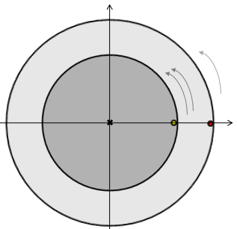
Scenario
You are required to :
Plot the behaviour of the vertical and horizontal displacements, h₁ and w₁, when the water wheel rotates.
Analyse how the vertical and horizontal displacements of the red dot are affected when:
The radius of the water wheel changes
The rotating speed of the water wheel changes
The centre point is shifted up by c units from the original reference level
In the figure on the right, a green dot rotates at twice the speed of the red dot, along a circle of radius half that of the circle of rotation of the red dot. Determine the angles at which the dots would have the same vertical or horizontal displacements.

Slide 6
Scenario Definition Template
What do we know?
What do we not know?
What do we need to find out?

Slide 7
Lesson Overview
S/N | Concepts | Slide Number
1 | Trigonometric properties | 8-9
2 | Graphs
i | Basic Sine Graph | 10-17
ii. | General Sine Graph | 18-20
iii | Basic Cosine Graph | 21
iv | General Cosine Graph | 22
v | Summary | 23-26
3 | Max and Min values of graphs | 27-28
4 | Positive and negative values for sine and cosine | 29
5 | Solving trigonometric equations | 30-36
6 | Trigonometric Identities (CL) | 37-39

Slide 8
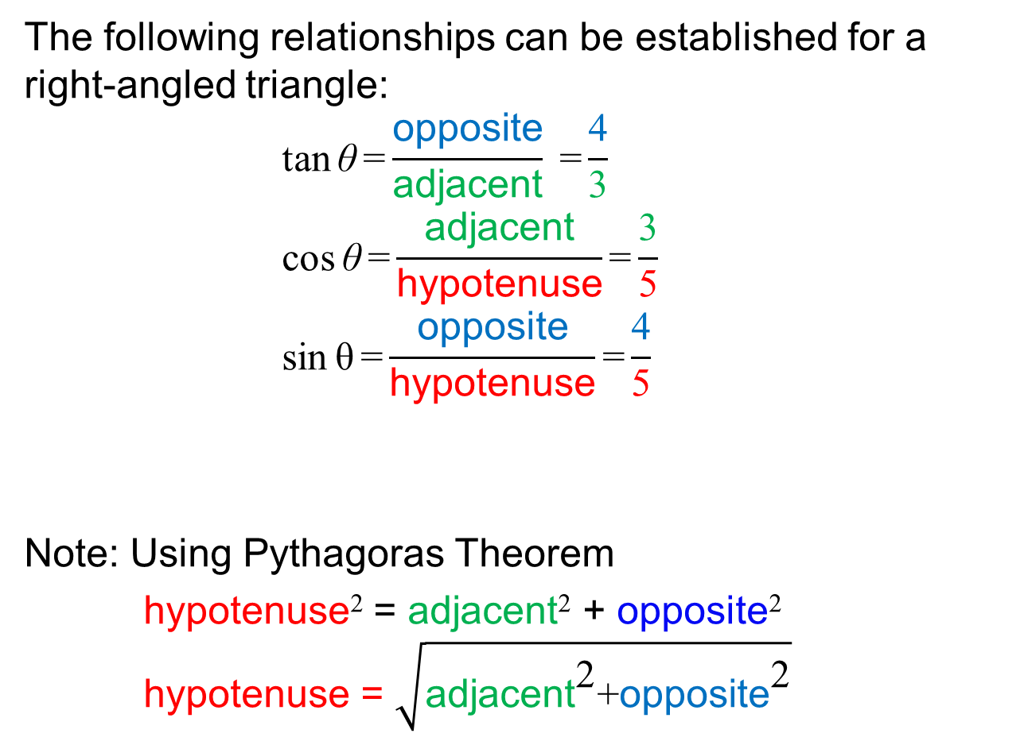

Trigonometric properties of a right-angled triangle
The following relationships can be established for a right-angled triangle:
$$\text{tan}{\text{θ}}\text{=}\frac{\text{opposite}}{\text{adjacent}} \text{=}\frac{\text{4}}{\text{3}}$$
$$\text{cos}{\text{θ}}\text{=}\frac{\text{adjacent}}{\text{hypotenuse}}\text{=}\frac{\text{3}}{\text{5}}$$
$$\text{sin}{\text{θ}}\text{=}\frac{\text{opposite}}{\text{hypotenuse}}\text{=}\frac{\text{4}}{\text{5}}$$
Note: Using Pythagoras Theorem
hypotenuse² = adjacent² + opposite² hypotenuse = $\sqrt{{\text{adjacent}}^{\text{2}}\text{+}{\text{opposite}}^{\text{2}}}$
“TOA”
“CAH”
hypotenuse = 5
opposite =4
“SOH”
$$θ$$
adjacent =3

Slide 9

Test Yourself
Determine the following trigonometric ratios
ϕ
13
12
θ
5

Slide 10
Basic sine graph: y = sinθ
θ (°) | sinθ
0 | 0.00
15 | 0.26
30 | 0.50
45 | 0.71
60 | 0.87
75 | 0.97
90 | 1.00
105 | 0.97
120 | 0.87
135 | 0.71
150 | 0.50
165 | 0.26
180 | 0.00
195 | -0.26
210 | -0.50
225 | -0.71
240 | -0.87
255 | -0.97
270 | -1.00
285 | -0.97
300 | -0.87
315 | -0.71
330 | -0.50
345 | -0.26
360 | 0.00
Maximum = 1
y
y = sinθ
Symmetrical
θ (°)
Symmetrical
Minimum = –1

Slide 11
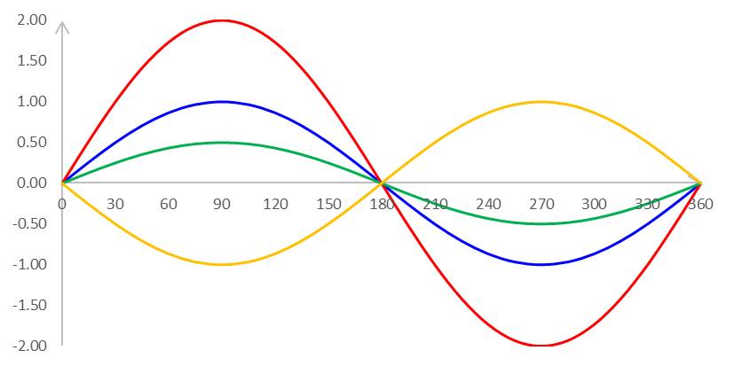
Sine graph: y = A sinθ
y
y = 2 sinθ
A affects the amplitude of the sine graph
The amplitude of y = 2 sinθ is 2 times that of y = sinθ.
The amplitude of y = 0.5 sinθ is 0.5 times that of y = sinθ.
The graph of y = –sinθ is the image of that of y = sinθ along the horizontal axis.
The number of cycles remains unchanged and there is no shift along the horizontal axis or y-axis.
y = sinθ
y = 0.5 sinθ
θ (°)
y = –sinθ

Slide 12
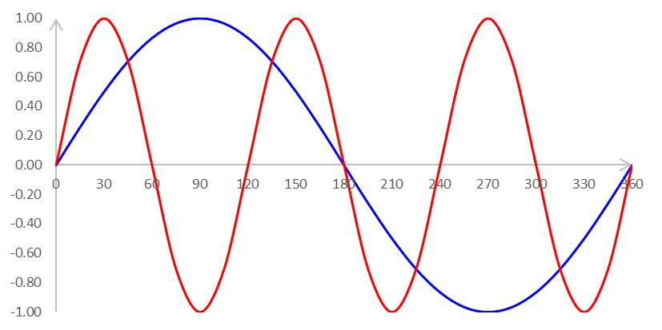
Sine graph: y = sin Bθ
y
y = sinθ
y = sin3θ
B affects the number of cycles of the sine graph for 0°≤ θ ≤ 360°
The number of cycles for y = sin3θ is 3 times that of y = sinθ.
The amplitude remains unchanged and there is no shift along any axis.
Also, , where 2π radians = 360°
θ (°)
Radian can be converted to degree
Similarly, degree can be converted to radian

Slide 13
Sine graph: y = sin(θ +C)
y
C affects the shift along the horizontal axis of the sine graph.
The graph for y = sin(θ + 60°) is 60° to the left of y = sinθ.
The graph for y = sin(θ – 60°) is 60° to the right of y = sinθ.
This is also known as phase shift of a cyclical graph.
The amplitude and number of cycles remains unchanged and there is no shift along the y-axis.
θ (°)

Slide 14

Poll (Kahoot.it)
What is the value of c for the expression of the sine graph
y = sin(x+c)?
y
x(°)

Slide 15
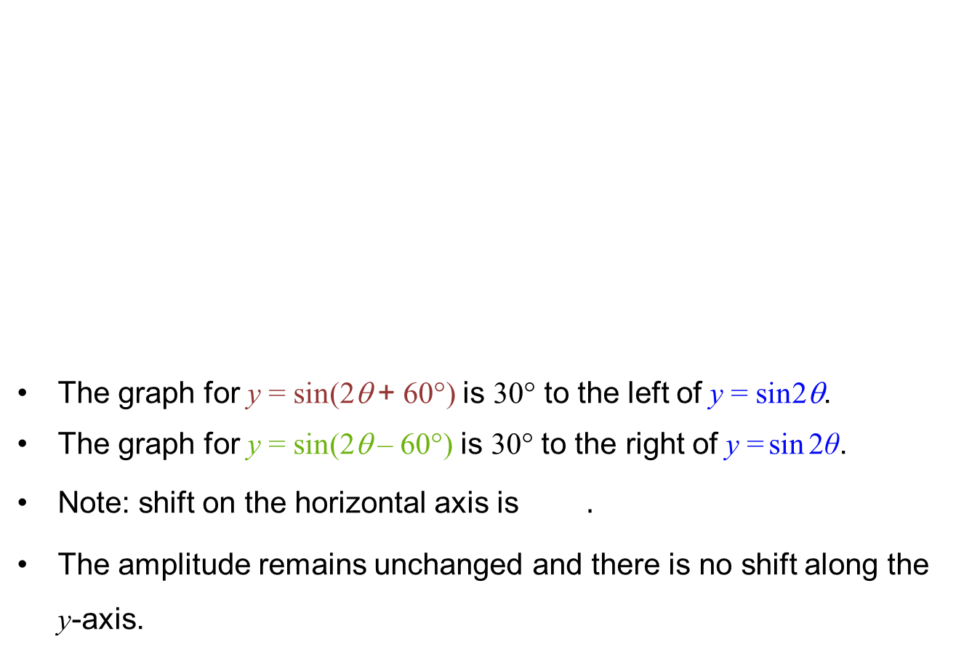
Sine graph y = sin(Bθ +C)
y
The graph for y = sin(2θ + 60°) is 30° to the left of y = sin2θ.
The graph for y = sin(2θ – 60°) is 30° to the right of $\text{y}\text{ =}\text{sin}{\text{2}\text{θ}}$.
Note: shift on the horizontal axis is $.$
The amplitude remains unchanged and there is no shift along the y-axis.
θ (°)

Slide 16
Think-Pair-Share
Given that a sine graph:
Completes 3 cycles in the range of 0°≤ θ ≤ 360°
Shift in the horizontal axis of 20° to the right
No shift along the y-axis
Write down the expression of the sine graph in the following form: y = sin(Bθ +C).

Slide 17
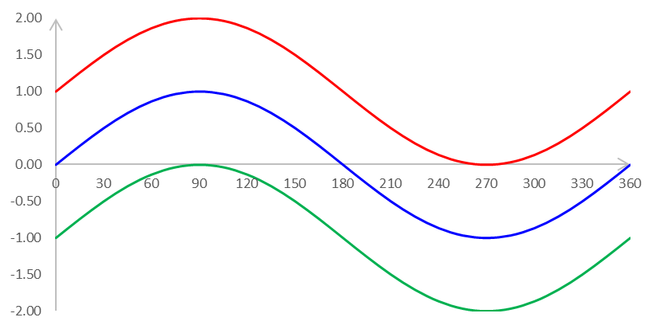
Sine graph: y = sinθ +D
y
y = sinθ + 1
D affects the shift along the y-axis of the sine graph.
The graph for y = sinθ + 1 is 1 unit up from that of y = sinθ.
The graph for y = sinθ – 1 is 1 unit down from that of y = sinθ.
The amplitude and number of cycles remains unchanged and there is no shift along the horizontal axis.
y = sinθ
y = sinθ – 1
θ (°)

Slide 18
General sine graph: y = A sin(Bθ+C)+D
A affects the amplitude of the sine graph:
B is the number of cycles of the sine graph within 360°
C affects the shift of the sine graph along the horizontal axis
D affects the shift of the sine graph along the y-axis:
Notes:
Illustrate a, k, c computation using graph in red

Slide 19
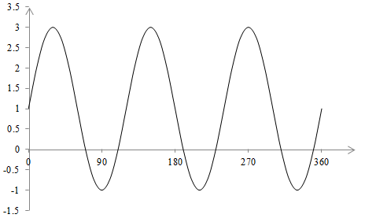
General sine graph: y = A sin(Bθ+C)+D
General sine graph: y = A sin(Bθ+C)+D
[Example] The graph below can be expressed as: y = A sin Bθ + D, where A, B and D are constants. Determine the values of A, B and D.
[Solution] The sine graph has a max at 3 and a min at –1. The amplitude is
→ A = 2 as this is a positive sine graph.
The sine graph has 3 complete cycles within 360°, → B = 3
The vertical shift of the graph is the average of its maximum and minimum:
y
θ (°)
y = 2sin3θ + 1

Slide 20
Think-Pair-Share
The graph below can be expressed as: y = a sin kθ + d, where a, k and d are constants. Determine the values of a, k and d.
y
θ (°)

Slide 21
Basic cosine graph: y = cosθ
θ (°) | cosθ
0 | 1.00
15 | 0.97
30 | 0.87
45 | 0.71
60 | 0.50
75 | 0.26
90 | 0.00
105 | -0.26
120 | -0.50
135 | -0.71
150 | -0.87
165 | -0.97
180 | -1.00
195 | -0.97
210 | -0.87
225 | -0.71
240 | -0.50
255 | -0.26
270 | 0.00
285 | 0.26
300 | 0.50
315 | 0.71
330 | 0.87
345 | 0.97
360 | 1.00
y
Maximum = 1
y = cosθ
Symmetrical
θ (°)
Minimum = –1

Slide 22
General cosine graph: y = A cos(Bθ+C)+D
A affects the amplitude of the sine graph:
B is the number of cycles of the sine graph within 360°
C affects the shift of the sine graph along the horizontal axis
D affects the shift of the sine graph along the y-axis:
Same as general sine graph!
Notes:
Illustrate a, k, c computation using graph in red

Slide 23
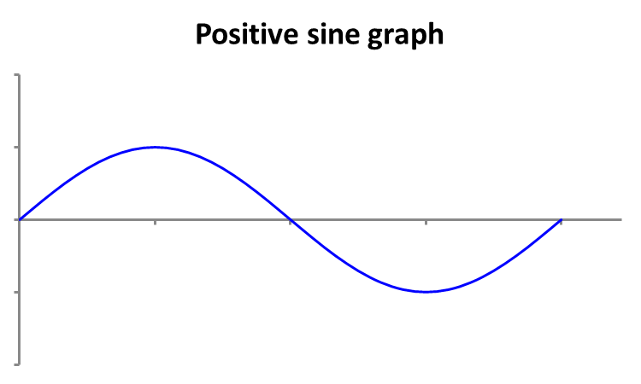
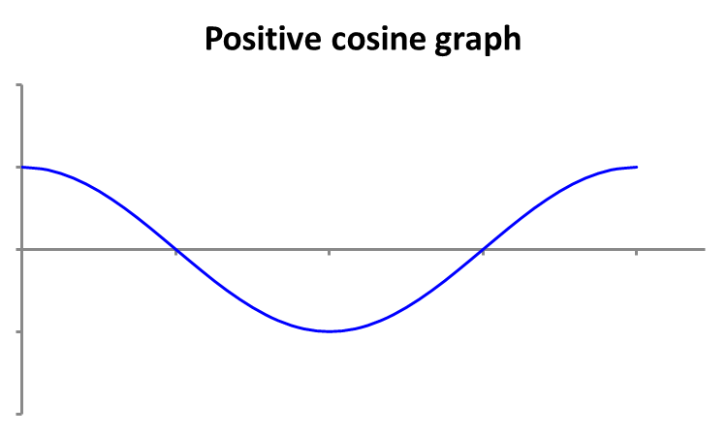
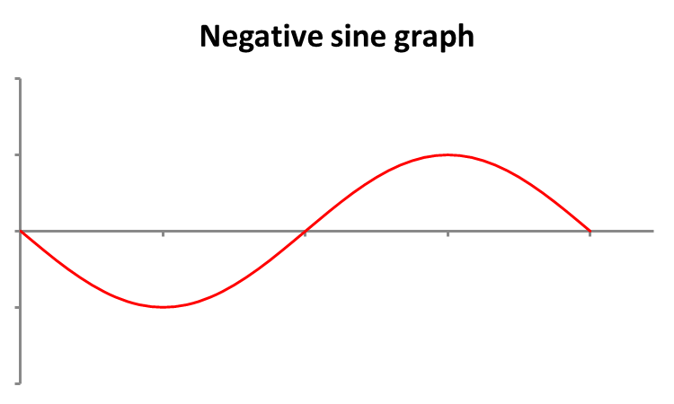
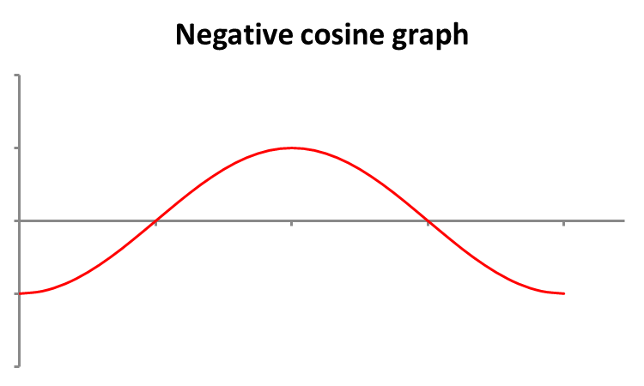
Summary of basic sine and cosine graphs
To write the equation of sine and cosine graphs, it is essential to identify the basic shapes of the graphs as summarised below.

Slide 24
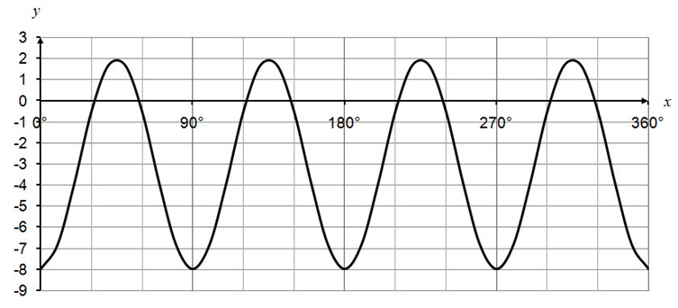
Test Yourself
The graph below can be expressed as: y = K cos Lx + M, where K, L and M are constants. Determine the values of K, L and M .

Slide 25
BRAIN BREAK
Improve by 1% a day,
and in just 70 days,
you’re twice as good.
-- Alan Weiss

Slide 26
Poll (Kahoot.it)
Select the equation that describes the following graph.
y
x(°)

Slide 27
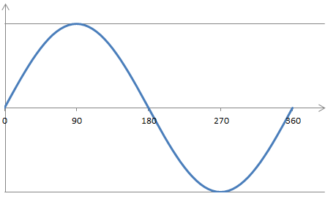
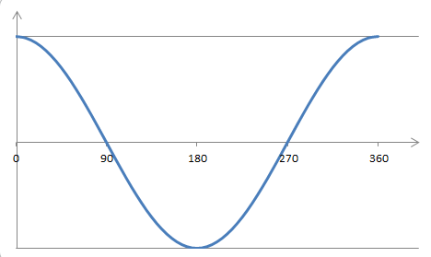
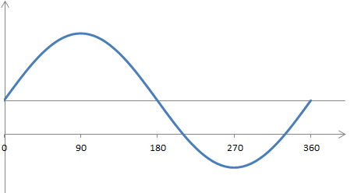
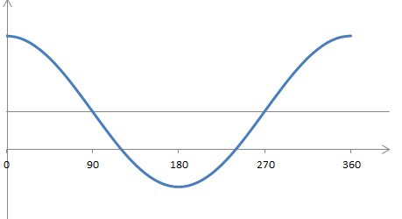
Max and Min values of graph
y
y
a
a
θ (°)
θ (°)
a
a
Graphs shift up by d units
y
y
a
a
d
d
a
a
θ (°)
θ (°)

Slide 28
Test Yourself
Identify the minimum and maximum values of the following graph:

Slide 29








Positive and negative values for sine and cosine
y = sinθ
y
$\text{sin}{\text{θ}}$ positive
$\text{sin}{\text{θ}}$positive
$\text{cos}{\text{θ}}$ negative
$\text{cos}{\text{θ}}$ positive
90°
θ (°)
2nd quadrant
1st quadrant
1st quadrant
2nd quadrant
3rd quadrant
4th quadrant
180°
y
3rd quadrant
4th quadrant
0°
θ (°)
270°
$\text{sin}{\text{θ}}$ negative
$\text{sin}{\text{θ}}$ negative
$\text{cos}{\text{θ}}$ negative
$\text{cos}{\text{θ}}$ positive
y = cosθ

Slide 30

Solving trigonometric equations
sinθ = b
y
sinθ = b > 0
2nd quadrant
θ = 180° – α
1st quadrant
θ = α
α
α
α
α
θ (°)
sinθ = b < 0
θ
1st quadrant
α
2nd quadrant
180° – α
3rd quadrant
180° + α
4th quadrant
360° – α
θ
α
α
α
α
y
cosθ = b > 0
θ
θ
α
α
α
α
θ (°)
3rd quadrant
$$\text{}\text{ = }\text{180}\text{°} \text{+ }\text{α}$$
4th quadrant
θ = 360° – α
cosθ = b < 0
cosθ = b

Slide 31
Solving trigonometric equations
[Example] Given , determine the value of θ, 0°≤ θ ≤ 360°, when y = 0.5.
[Solution]
Step 1: Find basic angle α = sin^{–1}(|0.5|) = 30°
Step 2: Since sin θ = 0.5 > 0 (positive), there are 2 solutions for θ, namely θ₁ in the 1st quadrant and θ₂ in the 2nd quadrant.
Step 3:
y
y = 0.5
α
α
θ (°)
θ₁
θ₂
y = sinθ
| x | → Modulus sign
Example :
|0.5| = 0.5
|–0.5| = 0.5
θ₁ =α = 30°
θ₂ =180°–α =180°–30°
= 150°

Slide 32
Think-Pair-Share
For 0°≤ θ ≤ 360°, solve

Slide 33
Test yourself
For 0°≤ θ ≤ 360°, solve

Slide 34
Trigonometric equations with multiple cycles
[Example] For 0°≤ θ ≤ 360° , solve .
[Solution] Consider the same graph on two different axes:
0°≤ 2θ ≤ 720° and 0°≤ θ ≤ 360°
Step 1:
Step 2: sin2θ > 0 → 1st and 2nd quadrants
Step 3:
y
y
y = sin2θ
y = sin2θ
2θ
θ
Note:
For 2 cycles within 360°, we have to add 360° to the single cycle answer(s) before division!
(i.e. 4 possible values)

Slide 35
Test yourself
For 0°≤ θ ≤ 360° , solve

Slide 36
Solving trigonometric equations (Summary)
Simplify the trigonometric equation:
Determine range of angles to be solved:
, for 0° ≤ θ ≤ 360° → 2 values
, for 0° ≤ θ ≤ 360° → 4 values
, for 0° ≤ θ ≤ 180° → 2 values
Find basic angle α, using or .
Determine the quadrants for the solution and find respective angles.
For multiple angles, divide by the number of cycles to find θ.

Slide 37
Trigonometric Identities (CL)
The following trigonometric identities may help to simplify equations.
Pythagorean identities
Double-angle formulas
Note:

Slide 38
Application of Trigonometric Identities (CL)
[Example] For 0° ≤ θ ≤ 360°, solve
[Solution]
(from previous example in slide 32)
Double angle formula for sine

Slide 39
Poll (CL)
Given sin A = 0.5, without finding the value of angle A, what is the value of cos 2A?
(1) 1
(2) 0.5
(3) 0
(4) –0.5
(5) –1

Slide 40
One-minute write
Please stop what you are doing and produce a written response to either of the following in only one minute:
Identify what is the key learning concepts from the seminar, or
Write down a question with respect to the concepts learnt so far.
Link:

Slide 41
Learning Objectives
State the periodic and algebraic properties of trigonometric (Sine and Cosine) functions in the context of a unit-circle.
Solve problems using trigonometric ratios and identities.
Model real-world applications using trigonometric functions (e.g. simple pendulum, waterwheel, estimation of large distances, etc.).
Solve real-world problems involving trigonometric functions using trigonometric ratio and identities (e.g. solving of right-angle triangles, harmonic oscillation, etc.).

